Slide 1
COMMON TABLE EXPRESSION (CTE)

Slide 2
Agenda
What is CTE
Structure of CTE
Recursive CTE Structure
Syntax and Semantics of a Recursive CTE
More on Recursive CTE
Where do I use CTE
Examples

Slide 3
What is CTE
Common Table Expressions ,generally termed as CTE is a non persistent view
Common Table Expressions are part of ANSI SQL 99
Microsoft refers to a CTE as a “temporary, named result set”
It is defined within the execution scope of a single SELECT, INSERT, UPDATE, DELETE, or CREATE VIEW statement
A CTE is similar to a derived table in that it is not stored as an object and lasts only for the duration of the query
Unlike a derived table, a CTE can be self-referencing and can be referenced multiple times in the same query
A common table expression can include references to itself, commonly known as Recursive CTE.
Common Table Expressions offer the same functionality as a view, but are ideal for one-off usages where you don't necessarily need a view defined for the system.
CTE comes in two forms
Recursive –Self Referencing CTE within itself
Non Recursive-which does not reference itself within the CTE

Slide 4
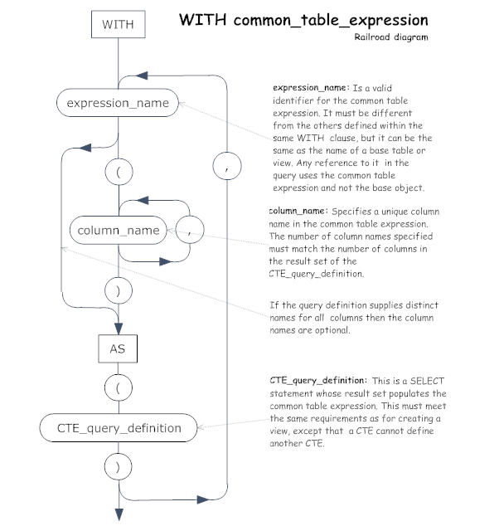
Structure of a CTE
A CTE is made up of
an expression name representing the CTE
an optional column list
a query defining the CTE
After a CTE is defined, it can be referenced like a table or view can in a SELECT, INSERT, UPDATE, or DELETE statement.
The basic syntax structure for a CTE is:
WITH expression_name
[ ( column_name [,...n] ) ]
AS
( CTE_query_definition )
The statement to run the CTE is:
SELECT <column_list>
FROM expression_name;

Slide 5
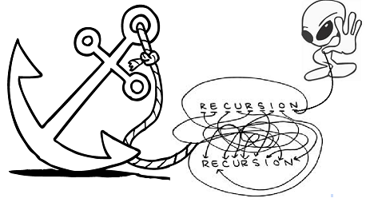
Recursive CTE - Structure
A recursive CTE consists of three elements:
Invocation of the routine-Anchoring
The first invocation of the recursive CTE consists of one or more CTE_query_definitions joined by UNION ALL, UNION, EXCEPT, or INTERSECT operators referred as anchor member
Recursive invocation of the routine.
The recursive invocation includes one or more CTE_query_definitions joined by UNION ALL operators that reference the CTE itself referred to as recursive members.
Termination check.
The termination check is implicit; recursion stops when no rows are returned from the previous invocation.

Slide 6
Syntax and Semantics of Recursive CTE
WITH cte_name ( column_name [,...n] )
AS
(
CTE_query_definition –- Anchor member is defined.
UNION ALL
CTE_query_definition –- Recursive member is defined referencing cte_name.
)
-- Statement using the CTE
SELECT *
FROM cte_name
The semantics of the recursive execution is as follows:
Split the CTE expression into anchor and recursive members.
Run the anchor member(s) creating the first invocation or base result set (T0).
Run the recursive member(s) with Ti as an input and Ti+1 as an output.
Repeat step 3 until an empty set is returned.
Return the result set. This is a UNION ALL of T0 to Tn.

Slide 7
More on Recursive CTE
MAXRECUSION can be used to control the number times the recursive part of the query is executed i.e. the SELECT statement that references the CTE.The default value for MAXRECUSION is 100.The maximum number you can set when using the MAXRECUSIVE query hint is 32,767.
In Recursive CTEs, it’s not possible to have multiple query definitions (i.e. multiple CTEs [, separated]) within a single “WITH” statement.
All anchor members supports UNION ALL, UNION, INTERSECT, or EXCEPT for combining the anchor definition. But only UNION ALL is supported for combining the last anchor member and the first recursive member and even for multiple recursive members.
The total number of columns and the data types of those columns must match for the anchor member and the recursive member. (Note: data type should be same for recursive member and the corresponding anchor member)
CTE expression_name can be referenced only once in the FROM clause of a recursive member.

Slide 8
Where do I use them?
For Pagination along with Row_number and Partition by clauses
Reference the resulting table multiple times in the same statement.
Substitute for a view when the general use of a view is not required; that is, you do not have to store the definition in metadata.
Enable grouping by a column that is derived from a scalar subselect, or a function that is either not deterministic or has external access.
improved readability and ease in maintenance of complex queries
Recursive CTEs are used with Hierarchical Data such as
Bill of Materials
Organizational Chart
Family Tree

Slide 9
Example-Non Recursive CTE
The following example shows the average number of sales orders for all years for the sales representatives.
WITH Sales_CTE (SalesPersonID, NumberOfOrders) AS
(
SELECT SalesPersonID, COUNT(*)
FROM
Sales.SalesOrderHeader
WHERE SalesPersonID IS NOT NULL
GROUP BY SalesPersonID
)
SELECT
AVG(NumberOfOrders) AS "Average Sales Per Person“
FROM
Sales_CTE;
GO

Slide 10
Example- Recursive CTE
The following example shows the hierarchical list of managers and the employees who report to them. The example begins by creating and populating the dbo.MyEmployees table.
CREATE TABLE dbo.MyEmployees ( EmployeeID smallint NOT NULL,
FirstName nvarchar(30) NOT NULL,
LastName nvarchar(40) NOT NULL,
Title nvarchar(50) NOT NULL,
DeptID smallint NOT NULL,
ManagerID int NULL,
CONSTRAINT PK_EmployeeID PRIMARY KEY CLUSTERED (EmployeeID ASC) );
-- Populate the table with values.
INSERT INTO dbo.MyEmployees
VALUES (1, N'Ken', N'Sánchez', N'Chief Executive Officer',16,NULL) ,
(273, N'Brian', N'Welcker', N'Vice President of Sales',3,1) ,
(274, N'Stephen', N'Jiang', N'North American Sales Manager',3,273) ,
(275, N'Michael', N'Blythe', N'Sales Representative',3,274) ,
(276, N'Linda', N'Mitchell', N'Sales Representative',3,274) ,
(285, N'Syed', N'Abbas', N'Pacific Sales Manager',3,273) ,
(286, N'Lynn', N'Tsoflias', N'Sales Representative',3,285) ,
(16, N'David',N'Bradley', N'Marketing Manager', 4, 273) ,
(23, N'Mary', N'Gibson', N'Marketing Specialist', 4, 16);

Slide 11
Example- Recursive CTE contd.,
USE AdventureWorks2012;
GO
;WITH DirectReports(ManagerID, EmployeeID, Title, EmployeeLevel)
AS (
SELECT ManagerID, EmployeeID, Title, 0 AS EmployeeLevel
FROM dbo.MyEmployees
WHERE ManagerID IS NULL
UNION ALL
SELECT e.ManagerID, e.EmployeeID, e.Title, EmployeeLevel + 1
FROM dbo.MyEmployees AS e
INNER JOIN
DirectReports AS d
ON e.ManagerID = d.EmployeeID )
SELECT ManagerID, EmployeeID, Title, EmployeeLevel
FROM DirectReports
ORDER BY ManagerID;
GO

Slide 12
Summary
CTE is a non – persistent view.
There are two types of CTE: Non-Recursive CTE & Recursive CTE.
Non-Recursive does not reference itself within the CTE.
Recursive CTE references itself within the CTE.
Recursive CTE is useful when working with hierarchical data.

Slide 13
QUESTIONS

